Slide 1
Strength of Materials
Module 6 – Torsion
(Shaft & Spring)
Dr. G.Venkatachalam
Professor / SMEC
VIT Chennai Campus
Chennai

Slide 2
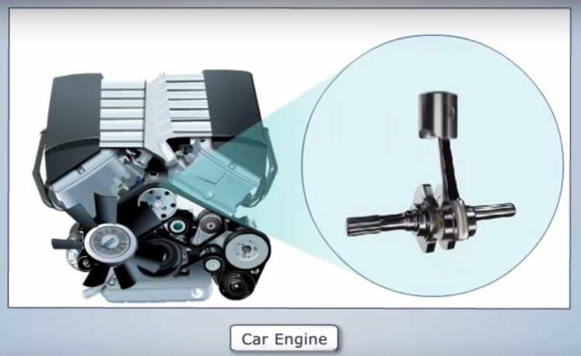

Slide 3
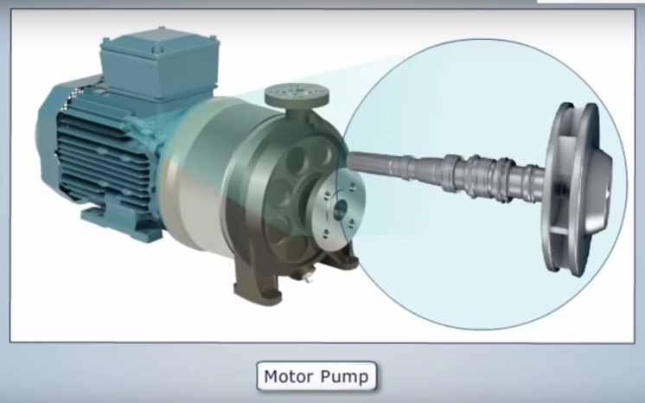

Slide 4
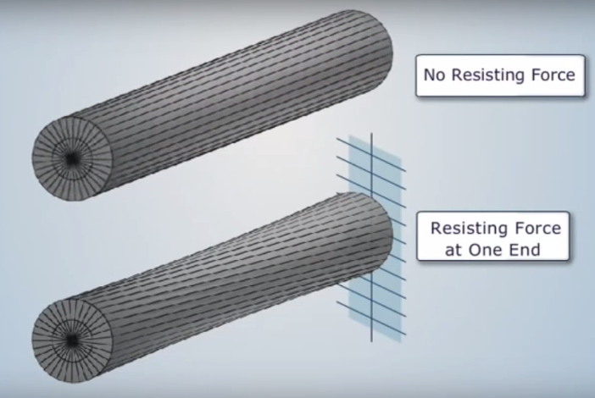

Slide 5
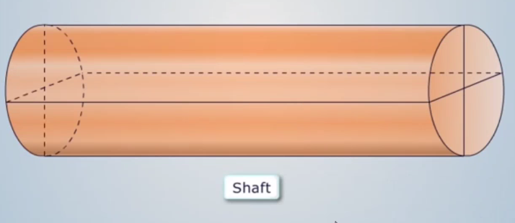
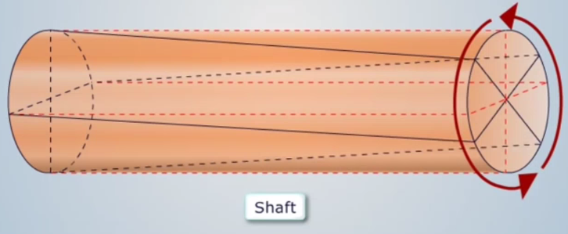
A – original position
A’ – New position

Slide 6
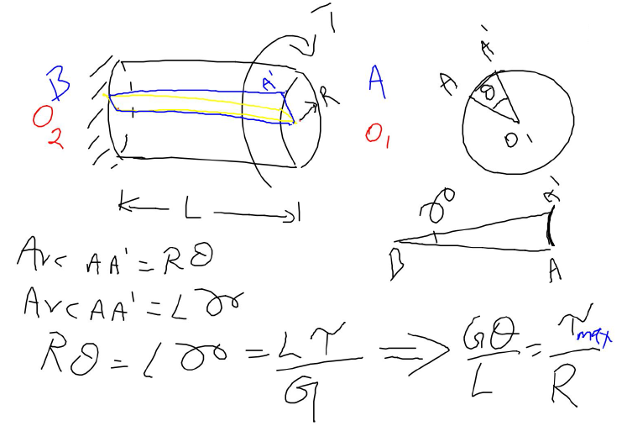
Torsion - Shaft
T – torque
L – Length
R – Radius
θ – Angle of twist
γ – Shear strain
G – Shear modulus
τ – Shear stress
Side view
Front view

Slide 7
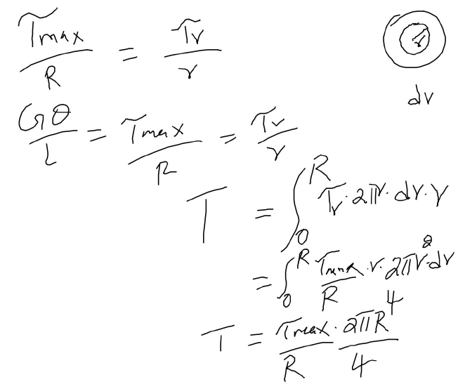
Ring – small portion is considered
d_{r} is ring thickness
Applied torque = summation of moment (ΣM = 0)

Slide 8
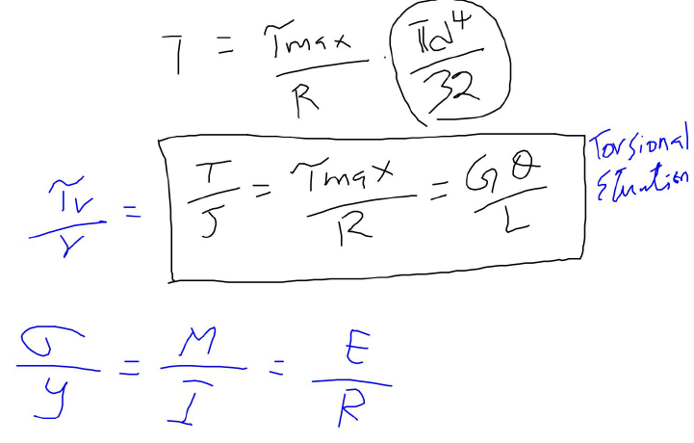
J – polar moment of inertia
Comparison
Bending Equation

Slide 9
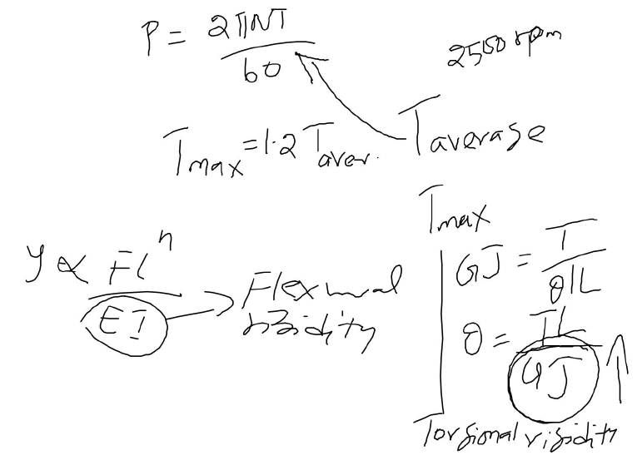
P – Power
N – rev / min
T - torques
T_{aver} in power eq
T_{max} in torque eq
Comparison

Slide 10
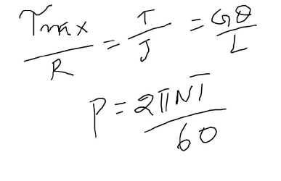
These 2 equations are sufficient to solve shaft problems

Slide 11
Tutorials

Slide 12
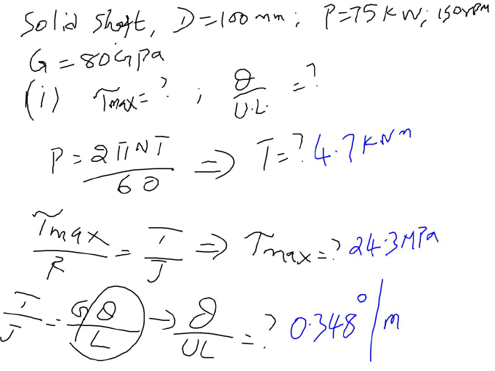
1

Slide 13
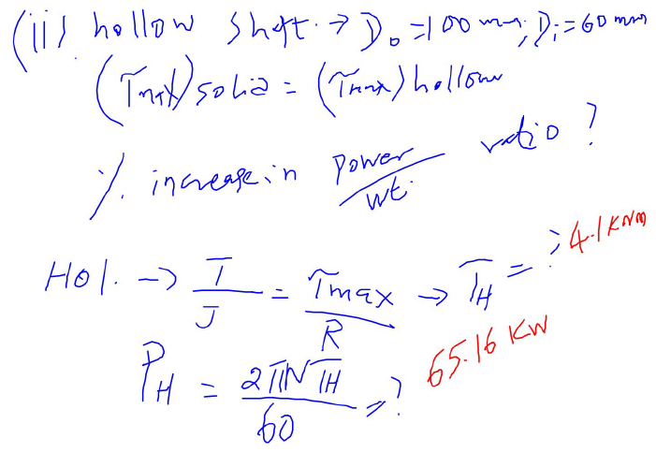
If maximum stresses are same in both solid and hollow shafts, find power to weight ratio. Outer dia of hollow is same as dia of solid shaft.

Slide 14
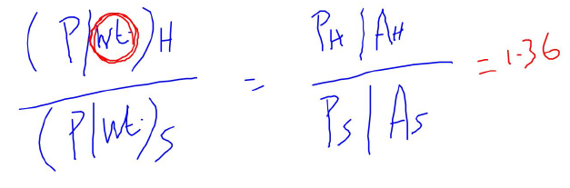
One can understand the advantage of using hollow shaft

Slide 15
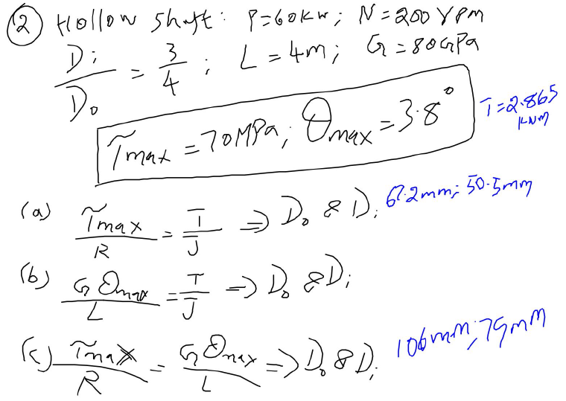
2
2 conditions are given

Slide 16
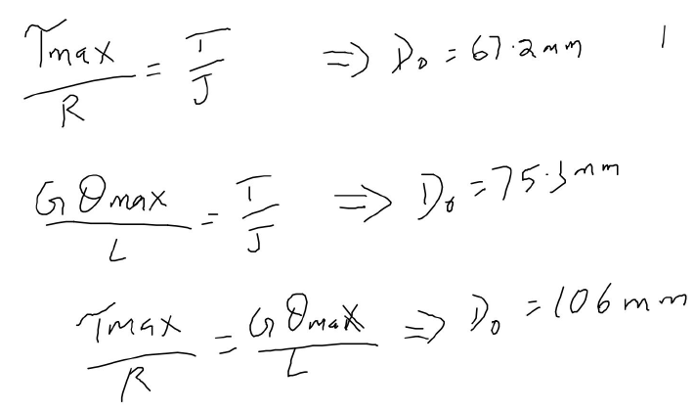

Slide 17
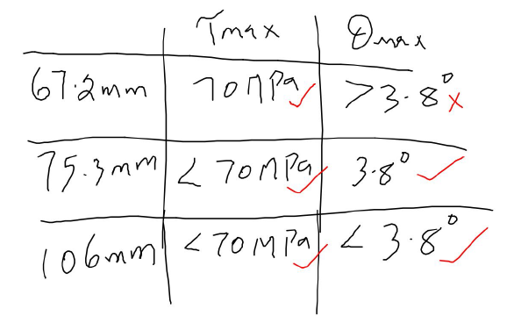
Both 75.3 mm shaft and 106 mm shaft satisfy both conditions. But using 106 mm shaft increases weight of the shaft. So considering material (cost) reduction, 75.3 mm shaft is preferred.

Slide 18
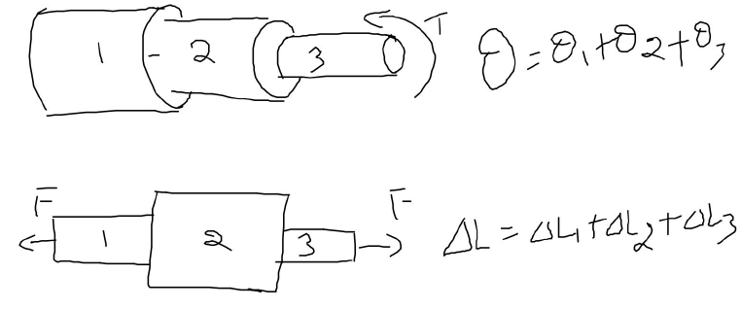
All 3 shafts are subjected to equal torque. Total angle of twist is the summation of angle of twists.
When shaft are in series….
Comparing axial load problem discussed in module 1…

Slide 19
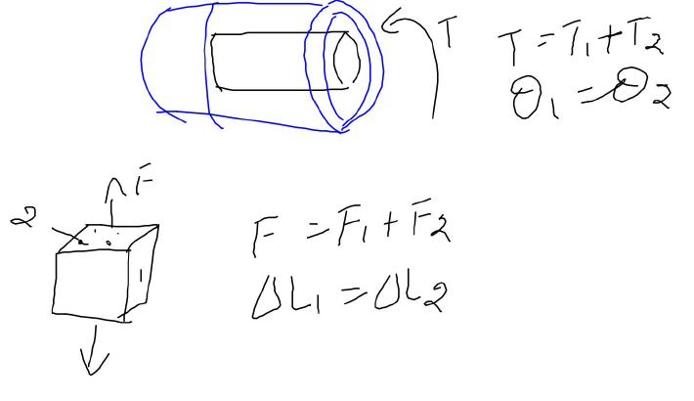
When shaft are in parallel….
Black shaft is placed inside blue shaft
Comparing forces in compound bars problem discussed in module 1…

Slide 20
Springs

Slide 21
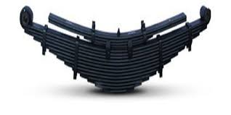
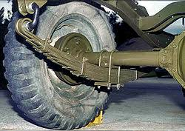
Leaf spring - Automobiles

Slide 22
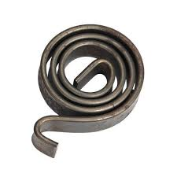
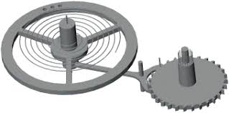
Spiral spring – clocks & watches

Slide 23
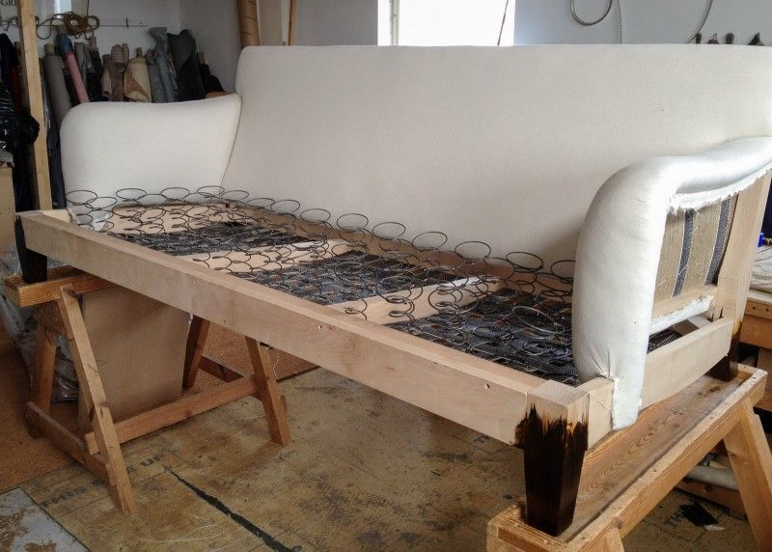
Springs in SOFA

Slide 24
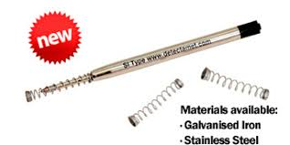
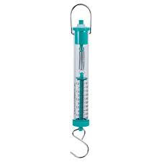
Springs in Ball point pen & Spring balance

Slide 25
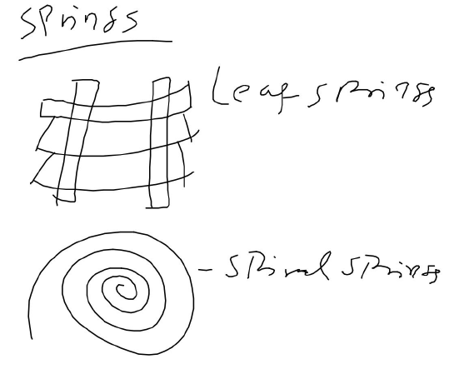
Automobiles
Clocks & wrist watches

Slide 26
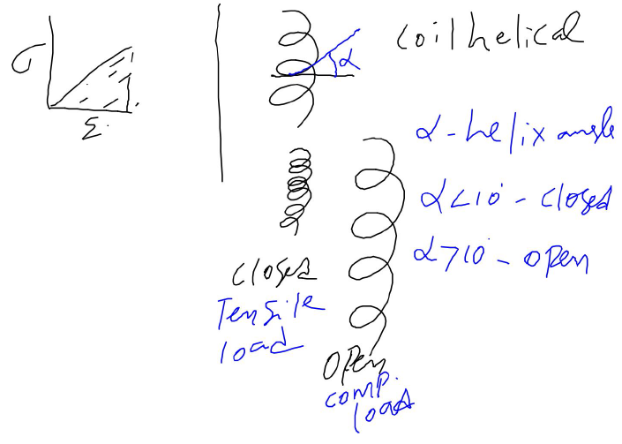
Resilience (hatched area) – important property for spring
Applications of coil helical spring??

Slide 27
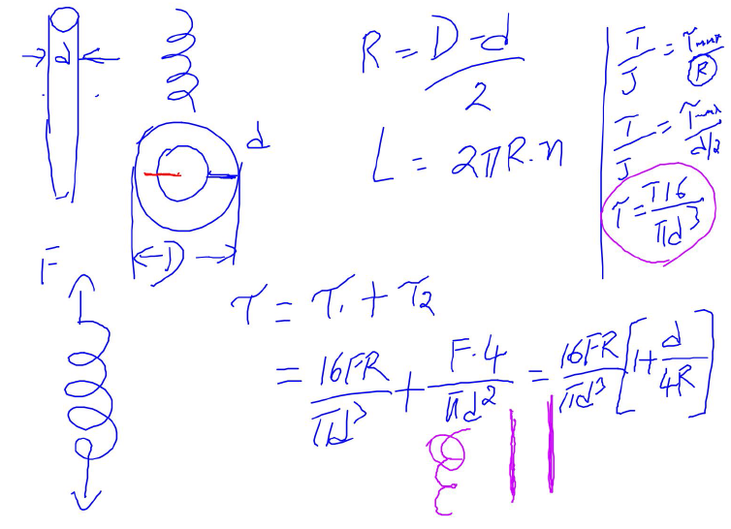
R – mean radius of the coil; L – length of wire to make spring; n – number of coils; D – outer dia of coil; d – inner dia of coil

Slide 28
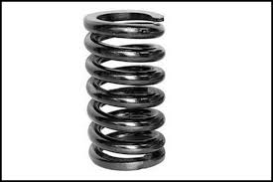
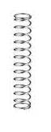
(d/R) ratio high
(d/R) ratio low

Slide 29
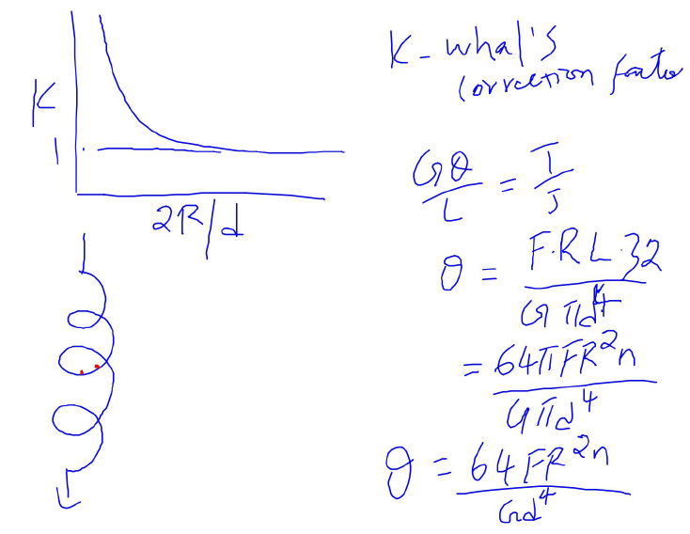

Slide 30
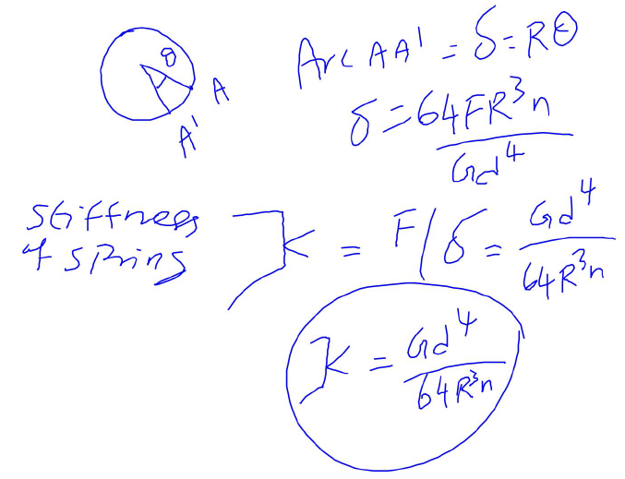
Κ – stiffness of the spring; G – shear modulus of the wire used to make spring; δ – deflection; F – applied axial tensile load; θ – angle of twist

Slide 31
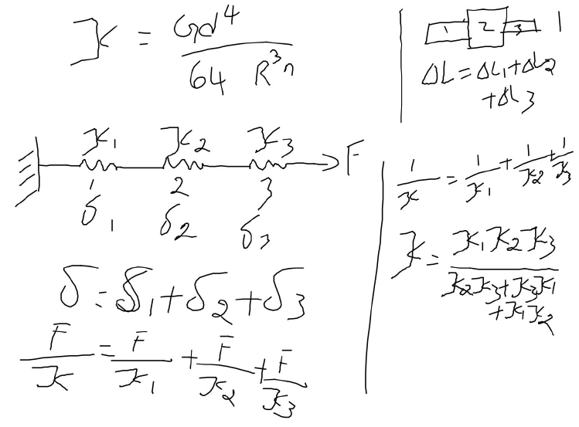
When springs are in series….
Comparing axial load problem discussed in module 1…
Equivalent spring constant to replace 3 springs

Slide 32
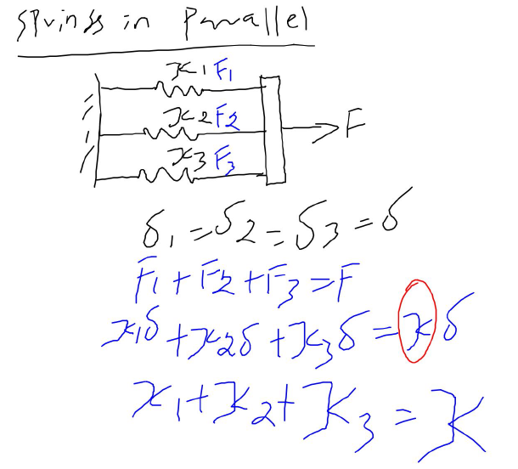
Equivalent spring constant to replace 3 springs
Compare forces in compound bars problem discussed in module 1…

Slide 33
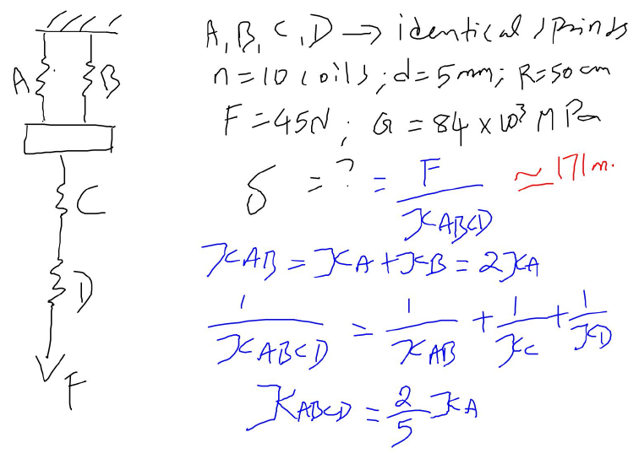
A & B are parallel to each other; combination of A&B are in series with C and D
Question

Slide 34
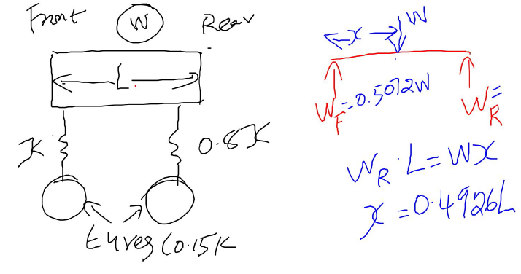
HOT Question
Vehicle – 4 wheels = front 2 + rear 2;
Find the centre of gravity – where total load acts?

Slide 35
Thank You

